Slide 1

Presented by: Group 4
Food Delivery
Database
System
2025
Team: Jun Lin, Ethan Liu, Louis Leong, Paramjeet Singh, Kshitij Kumar

Slide 2
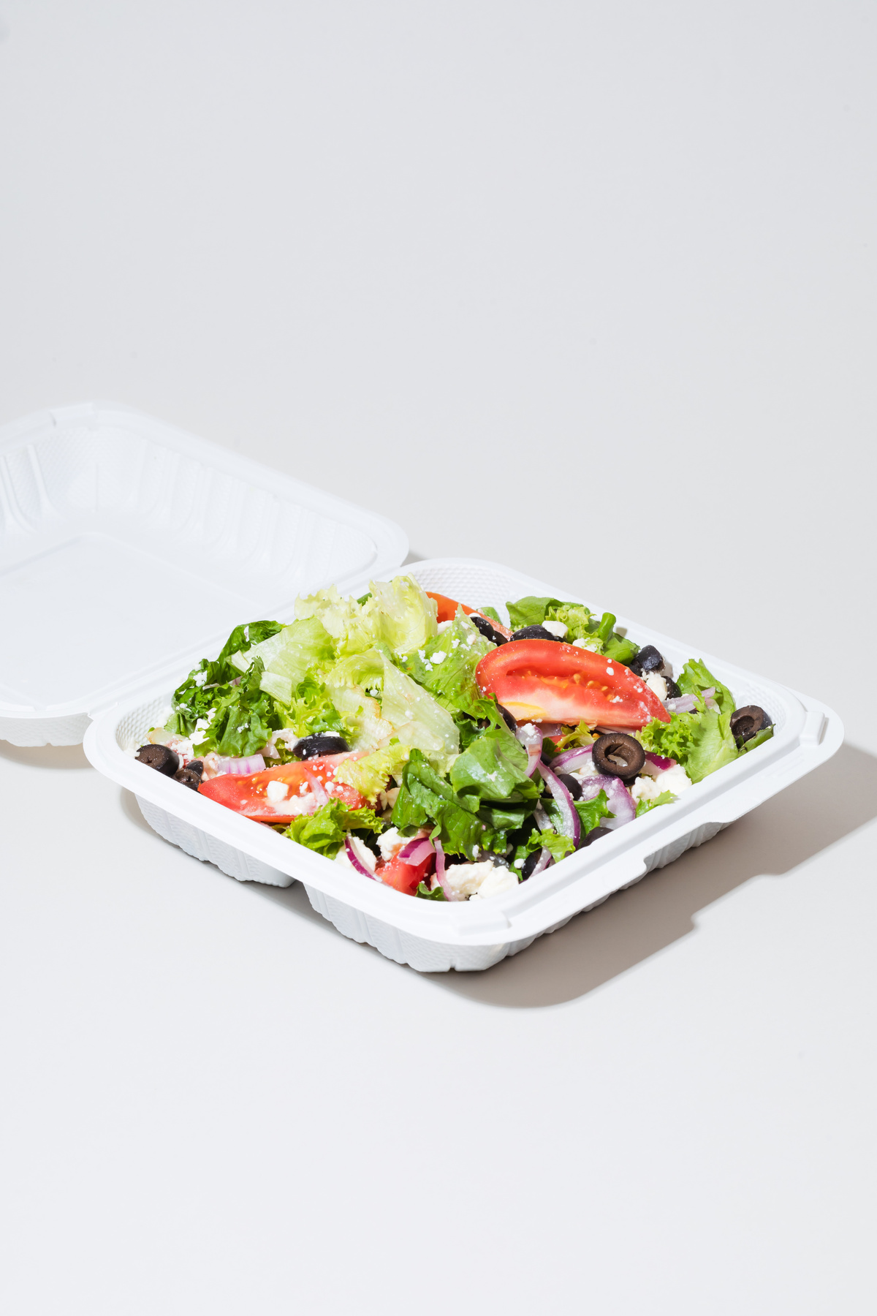
Project Overview
Mission
• Develop dependable system connecting clients with restaurants for efficient meal delivery
Key Components
• Customer Management
- Maintain profiles, addresses, and order history
• Order Processing
- Enable seamless ordering, status updates, and secure payments
• Restaurant Operations
- Manage menus, pricing, and availability
• Delivery Tracking
- Monitor driver status and delivery progress

Slide 3
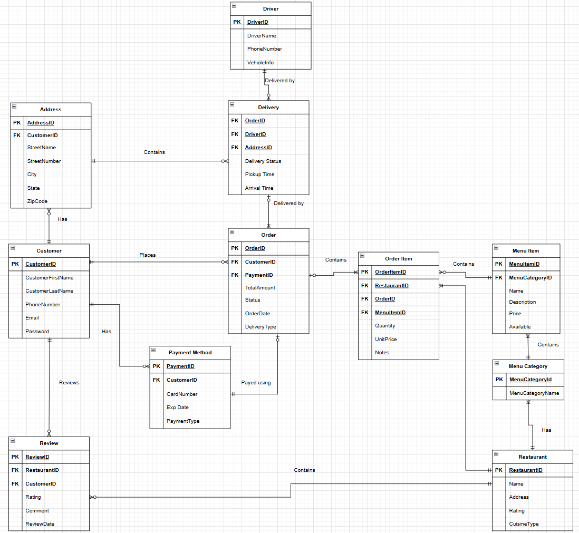
Entity
Relationship
Daigram

Slide 4
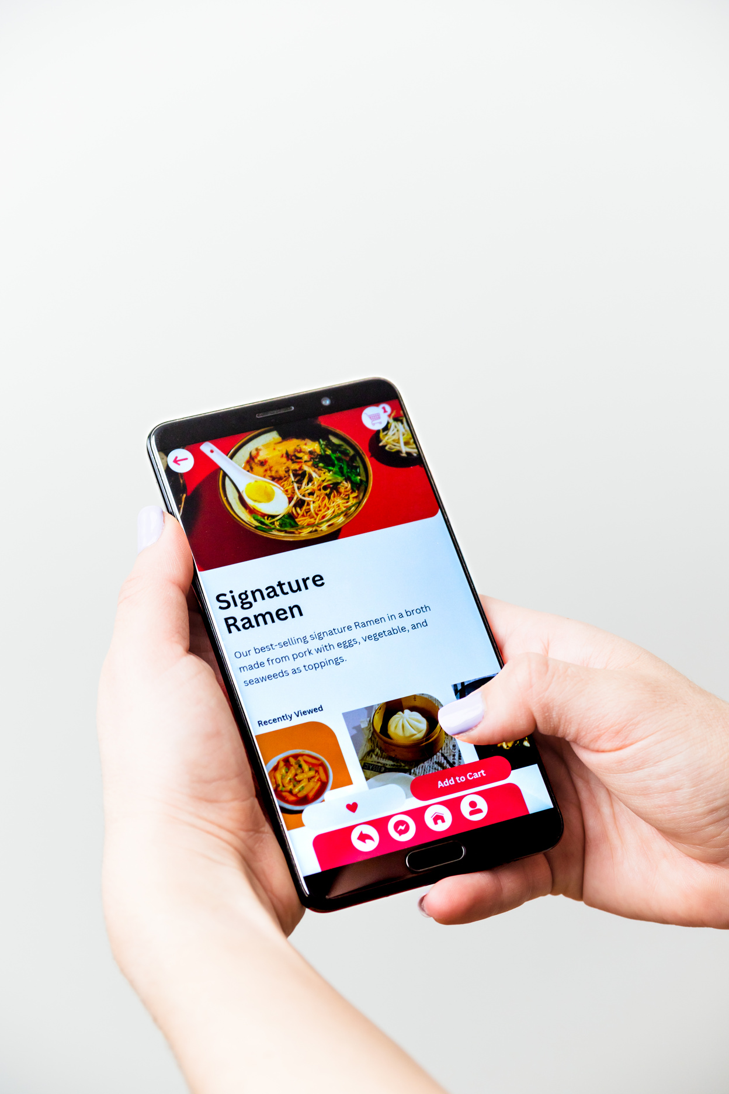
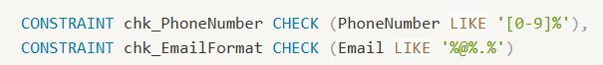
Implementation Highlights
Data Integrity Constraints
Rating System Implementation
Financial Validations

Slide 5
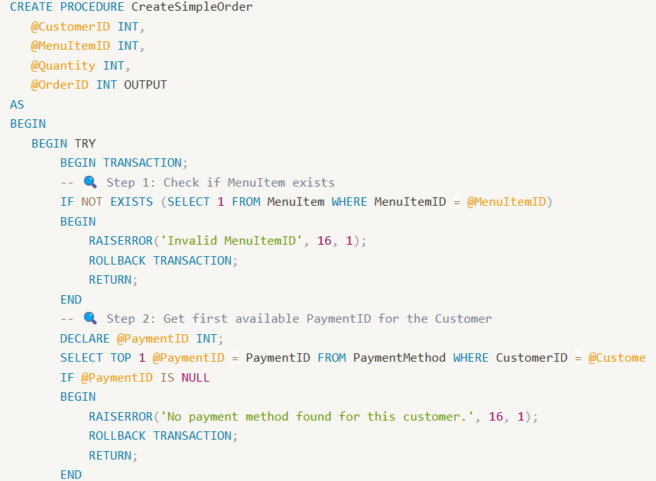
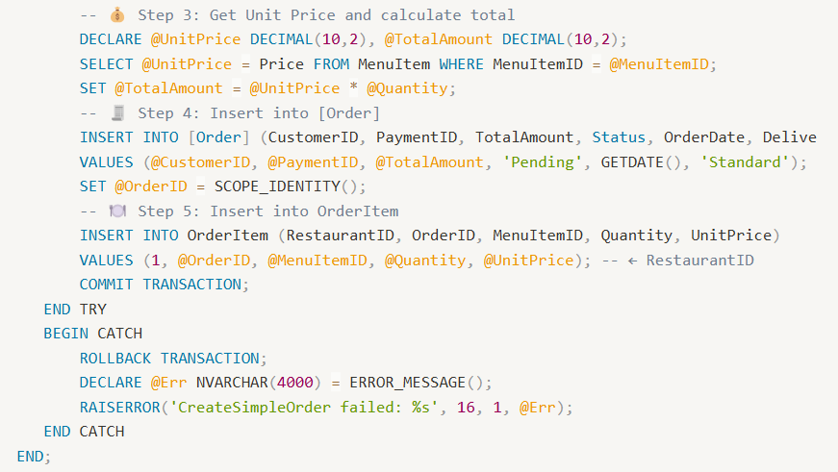
Implementation Highlights
Stored Procedure

Slide 6
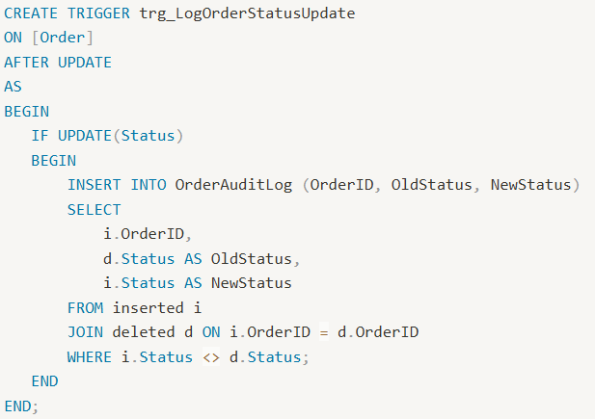
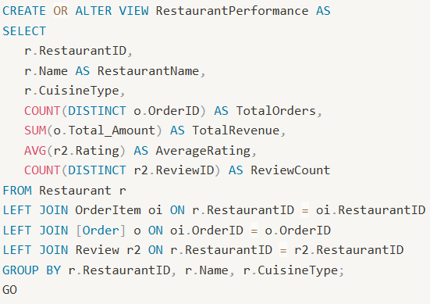
Implementation Highlights
Trigger
View

Slide 7
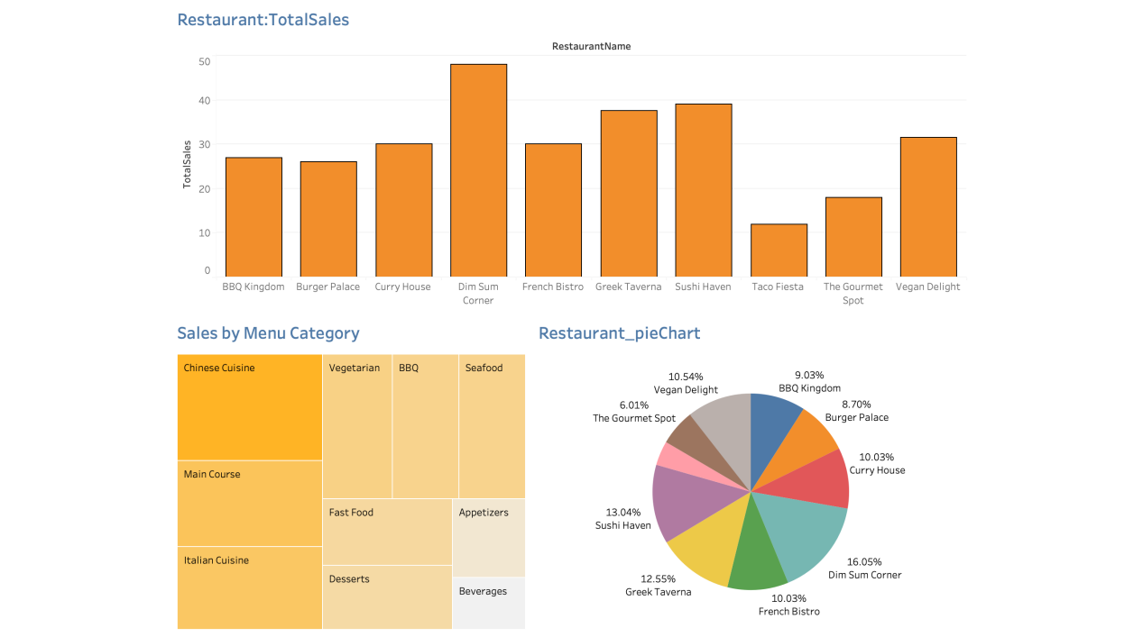
Data Visualization

Slide 8



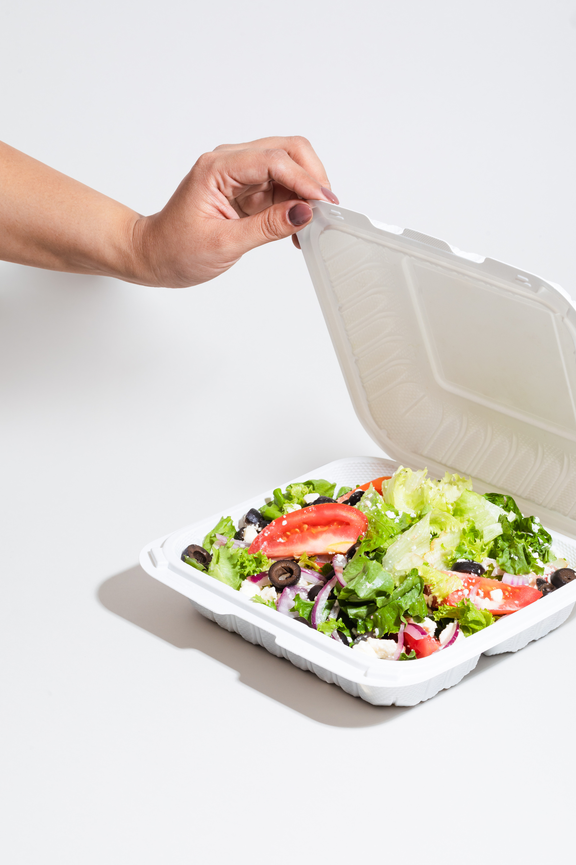
Fradel and Spies Co
Live Demo
@reallygreatsite

Slide 9

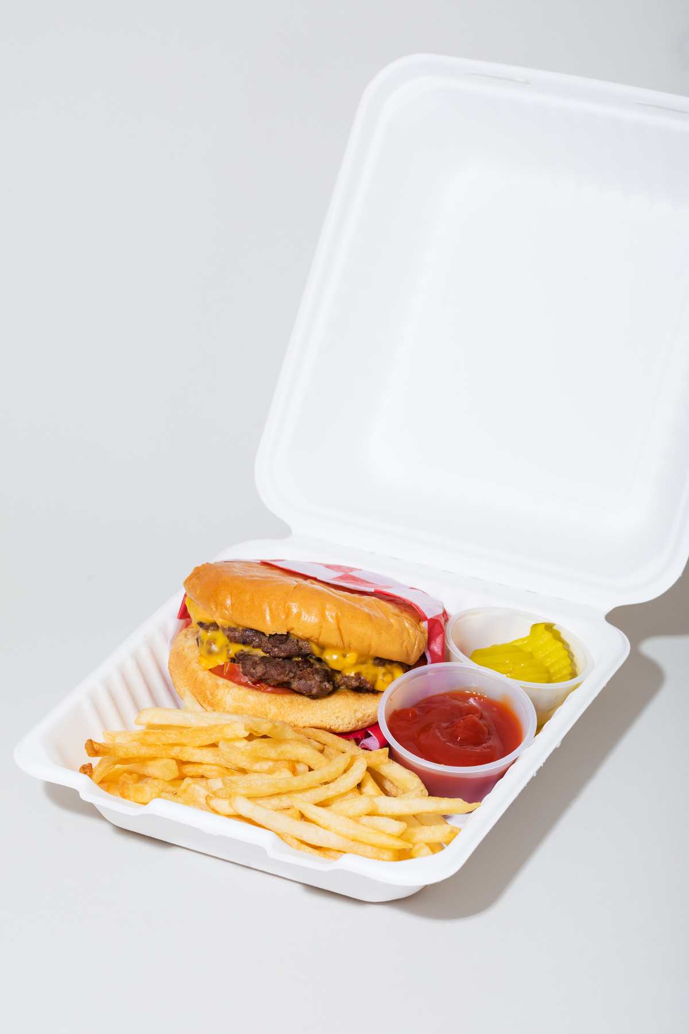



Thank you!

